Slide 1
Argument Splitting
UFCFWK-15-2 Operating Systems
Jonathan White
Lecturer in Cyber Security​
​
Jonathan6.White@uwe.ac.uk​
25th November 2021

Slide 2
Assignment Groups
To register your group, email Hamza.Attak@uwe.ac.uk listing all group members, including them in the CC field.
Groups can be up to four people
Deadline for group creation – December 17th 2021 - Students will be auto assigned a group after this date. (NOTE: This doesn’t leave you long to work as a group to complete the assignment. Do not rely on auto assignment!)

Slide 3
Assignment
First task to implement is argument passing.
Can be split into sub-tasks:
Split the arguments up into components
Build the stack (More detail next week)

Slide 4
argc & argv
argv is the “argument vector”
In C – is an array containing the arguments passed to a program through the command line
argc is the “argument count”
Contains a counter of the number of arguments contained in argv

Slide 5
Example Command:
/bin/ls –l foo bar
argv[0]
argv[1]
argv[2]
argv[3]
argv[0] = /bin/ls
argv[1] = -l
argv[2] = foo
argv[3] = bar
argc = 4

Slide 6
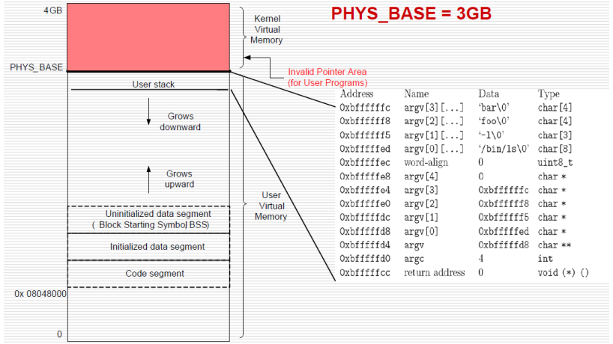
Building the stack:
argv’s
Padding (if required)
NULL
Address of each argv
Pointer to argv addresses
argc
Stack return address. 0 for first call

Slide 7
Q&A

